Slide 1

A Hybrid MapReduce Framework for SNP Selection
Presented by Group 13
Liu Pengfei 1155058548
Li Shuai 1155073198
Yi Weiying 1155026053

Slide 2
Background
Background
Motivation
Architecture
User Interface
Experiments
Conclusion

Slide 3
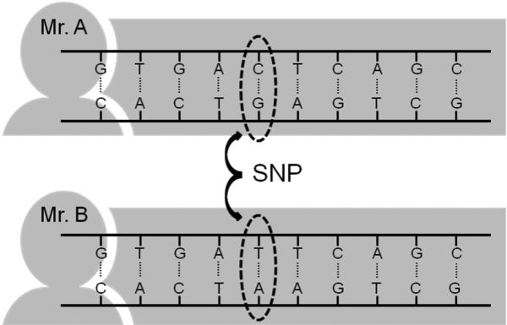
Single Nucleotide Polymorphisms
Background
Single nucleotide polymorphisms, frequently called SNPs, are the most common type of genetic variation among people.
Human DNA length 3 billion
1% of them are SNPs,
10 million SNPs
Many SNPs are related with diseases.

Slide 4
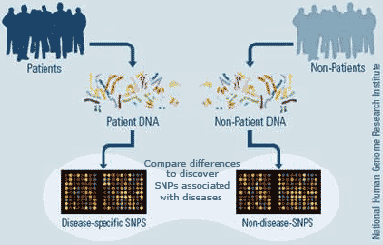
Genome-Wide Association Study
Background
Genome-Wide Association Study (GWA study, or GWAS), is an examination of many common genetic variants in different individuals to see if any variant is associated with a trait.
GWAS typically focus on associations between single-nucleotide polymorphisms (SNPs) and traits like major diseases.
1,1,2,2,1,1,0,…………………,0,0,1,0,0,0
Case:
2,1,2,0,2,1,0,…………………,0,1,1,0,1,2
1,1,1,0,0,0,1,…………………,0,0,1,0,1,1
High
dimension
Feature
Selection
1,1,0,0,0,1,0,…………………,1,1,1,0,0,2
Control:
0,0,0,1,0,1,0,…………………,0,2,2,1,1,0

Slide 5
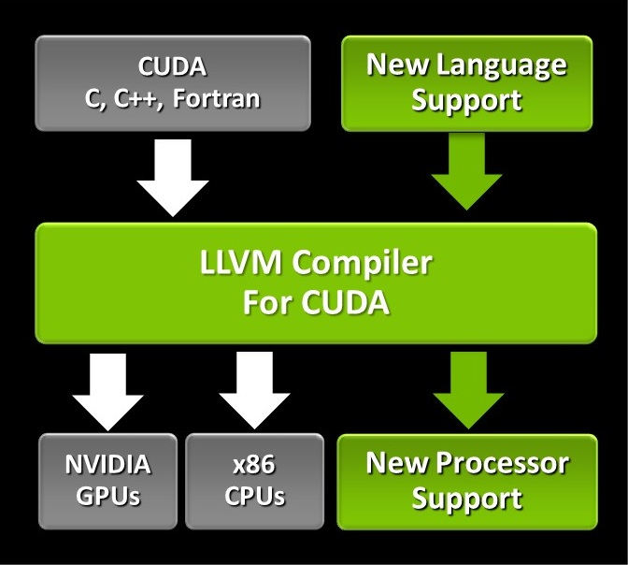
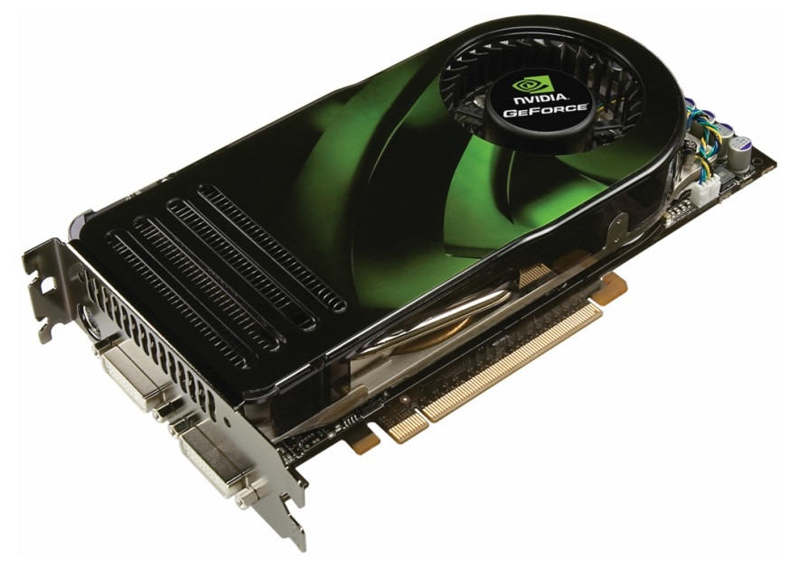
CUDA
CUDA ( Compute Unified Device Architecture)
--a parallel computing platform and application programming interface created by NVIDIA
Hardware supported (GPU)
Large scale parallelization (10⁶)
Convenient to learn (C, C++)

Slide 6
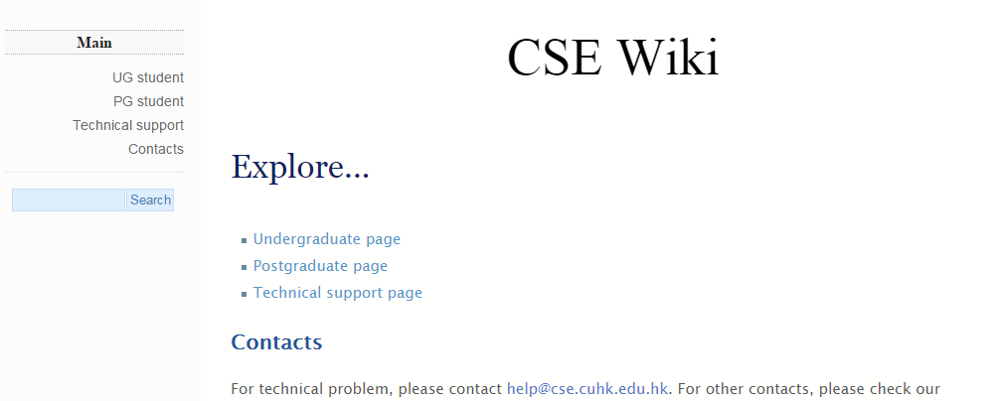


Resources in CSE CUHK
Linux1
….
Linux 17
Hpc1
…
Hpc9

Slide 7
Background
Motivation
Motivation
Architecture
User Interface
Experiments
Conclusion

Slide 8
Motivation
Motivation
Accelerating SNPs selection using MapReduce framework
Mapper :
-input: subset of all SNPs
-output: scores of each SNP
- (key = SNP, value = score)
Reducer:
-input: the output of mapper
-output: merged result of each mapper (various ways)
- (key = SNP, value = score’)
Multiple loops may be necessary based on different algorithms.

Slide 9
Background
Motivation
Architecture
Architecture
User Interface
Experiments
Conclusion

Slide 10


Architecture
Mission
Slave
Notify
Slave
Task
Slave
Progress
Master
Slave
Slave
Slave
Slave
Slave

Slide 11
Background
Motivation
Architecture
User Interface
User Interface
Experiments
Conclusion

Slide 12
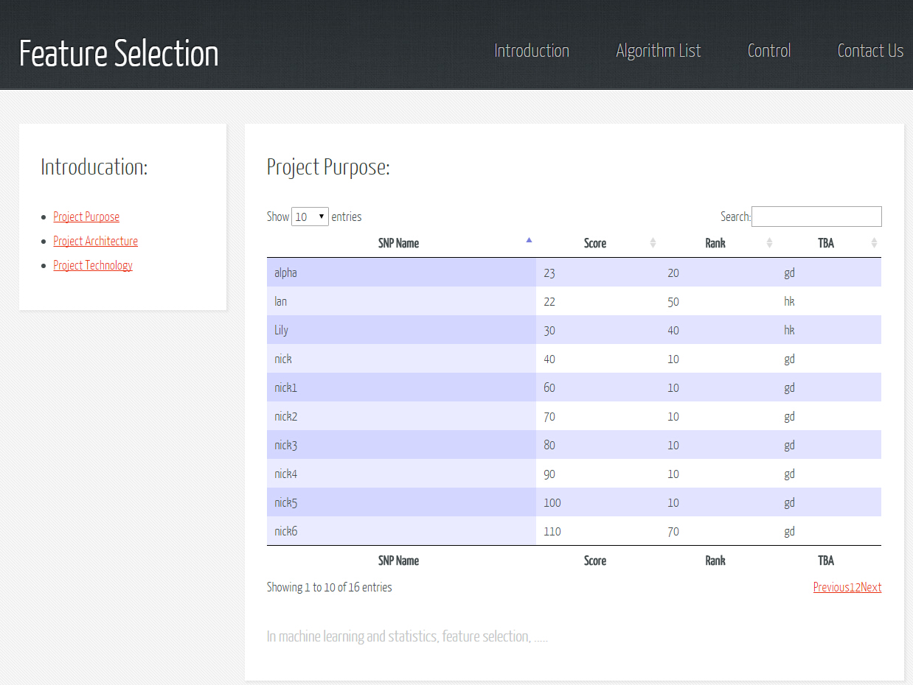

Slide 13
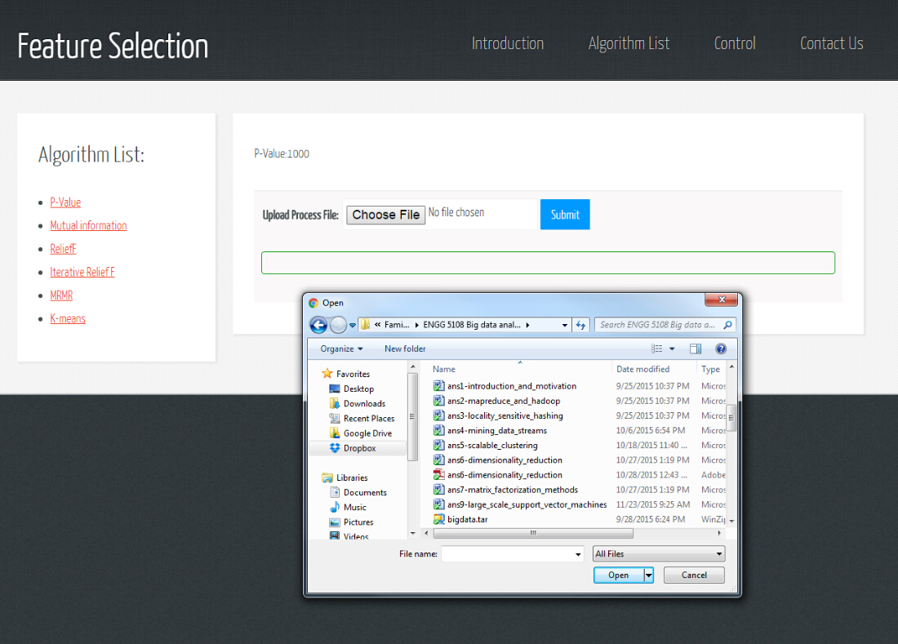

Slide 14
Background
Motivation
Architecture
User Interface
Experiments
Experiments
Conclusion

Slide 15
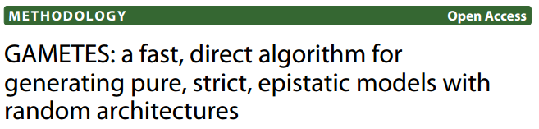

Synthetic Dataset Generator
Experimental setup
Synthetic Data
4 heritability * 50 files * 1k samples * 10k SNPs (8G)
Real Data
Source: Mayo-Perlegen LEAPS (Linked Efforts to Accelerate Parkinson’s Solutions)
2722 SNPs 316 abandoned (p-value)

Slide 16
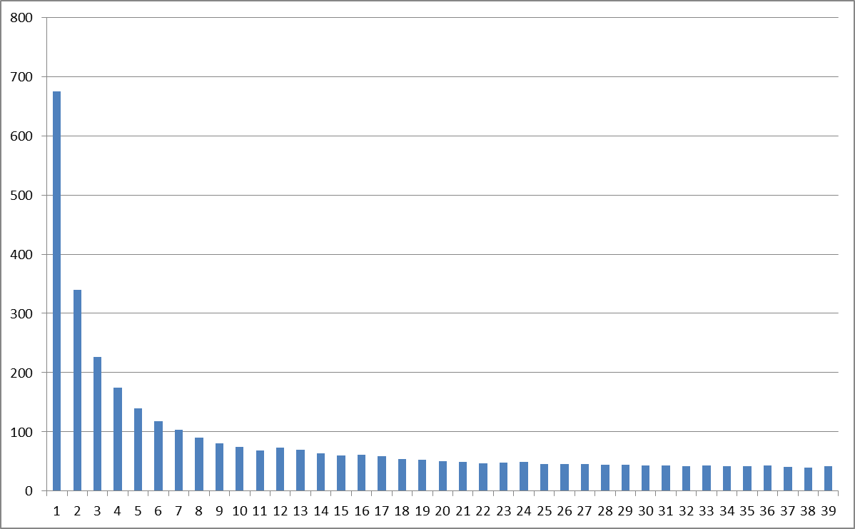
Acceleration (CPU)
Time / min
# of Slaves

Slide 17
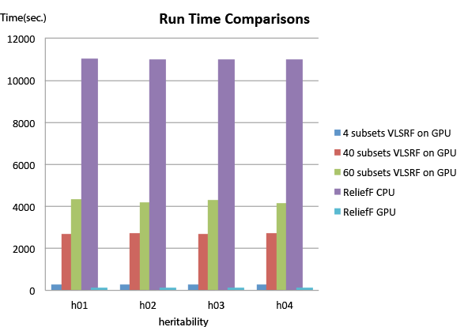

Acceleration (GPU)
$×$80

Slide 18
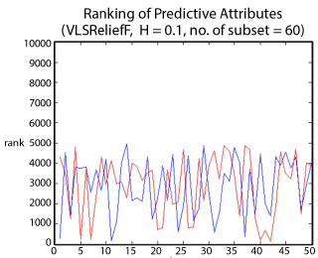
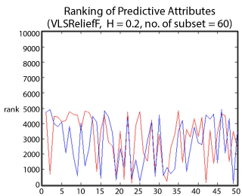

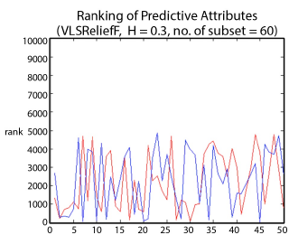
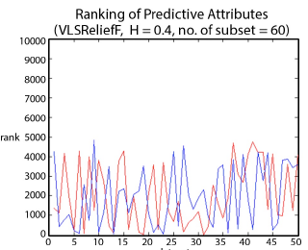
Accuracy (synthetic dataset)
Result Comparison
Dataset ID
Dataset ID
Dataset ID
Dataset ID

Slide 19
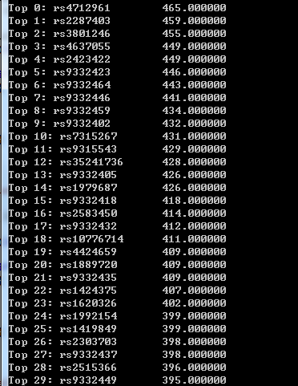
Accuracy (Real dataset)
Result Comparison
rs2287403
The experiment contains
2722 SNPs of tier 2b
316 SNPs that are abandoned
From the top 10% of the 316 abandoned SNPs
In published paper
3 Parkinson’s disease related SNPs
(Red Arrow)
In online database
2 potentially related SNPs
(Green Arrow)
rs9332464
rs1979687
rs1889720
rs2303703
Relief-F on real dataset

Slide 20
Background
Motivation
Architecture
User Interface
Experiments
Conclusion
Conclusion

Slide 21
Conclusion
Conclusion
Finished Work:
MapReduce framework
Hybrid system
User friendly interface
Future work:
Discussing with administrator….

Slide 22
Q & A
THANK YOU!

Slide 23
http://ec2-54-169-232-114.ap-southeast-1.compute.amazonaws.com/login.html

